Slide 1
BauLynq
Ein Bauprojekt. Ein durchgängiger Datensatz.
One project. One continuous record — the platform that connects German construction.
Seed Round — Investor Deck · July 2026
info@baulynq.com · +49 1525 4966510 · www.baulynq.com · live at app.baulynq.com

Slide 2
The product is already built — and live
This round buys distribution, not development.
10 + 1
1,465
3
21 days
modules + task layer
live at app.baulynq.com
automated backend tests
verified in-repo, Jul 18 2026
founding engineers — the platform
itself written by one of them
first-module go-live target
(proved by the H2 2026 pilots)
Deep where it wins deals: BidX and InrX — the GAEB/VOB/REB tender-and-billing core no point solution offers. The other modules provide connected adequacy on the same record; the moat is the continuous record, not ten best-of-breeds.
Platform written by one engineer in ~2 years — a scope funded teams typically approach with several million euros. €500k here buys go-to-market for a finished product, not product risk.
.NET 10 clean architecture · React 19 · German-first (de/en) · GAEB · VOB · DIN 276 · HOAI · REB · XRechnung · GoBD · DSGVO · Azure EU (Germany)
BauLynq — Seed · July 2026 · Confidential · draft figures (Entwurf)
2

Slide 3
Ten days. Every month.
Month-end close at a German mid-size contractor — because every phase handover re-types the project.
1
Transfer errors — Quantities and prices drift between tender LV, contract LV and billing sheets.
The industry's actual system of record:
Abrechnung_final_v7.xlsx
LV_Kopie (3).xlsx
Nachtrag_neu_NEU.xlsx
Aufmaß_Baustelle_B.pdf
Stundenzettel_KW28.xlsx
2
Lost variations — Nachträge raised on site never reach the final invoice — margin already earned, never billed.
3
Duplicate master data — Subcontractors, machines, cost codes maintained in parallel Excel lists.
4
A ~10-day close — Spreadsheets and phone calls instead of a report.
BauLynq — Seed · July 2026 · Confidential · draft figures (Entwurf)
3

Slide 4
Why now — three legs, not one
The e-invoice mandate is the door-opener; the purchase reason is the month-end close.
2025
Receiving e-invoices
mandatory (all B2B)
2027
Issuing mandatory
> €800k prior-year turnover
2028
Issuing mandatory
for ALL domestic B2B
1
Regulation forces contact. The mandate itself can be met with a €20 converter — but it forces every target firm to open its invoicing process at a known date. An e-invoice from a wrong Excel quantity is a compliant wrong invoice.
2
Margin pressure makes the leak acute. After the 2023–25 downturn, contractors cannot afford billing leakage; DIW forecasts real growth returning (+1.7% 2026, +3.4% 2027) — recovery volume on broken data chains.
3
Generational handover. Mittelstand succession puts digital-native owners in charge of Excel-run companies; GoBD & DSGVO obligations stand even if the e-invoice calendar slips.
BauLynq — Seed · July 2026 · Confidential · draft figures (Entwurf)
4

Slide 5
One project. One continuous record.
The LV (bill of quantities) is the backbone — every phase deepens the same dataset.
✓ The tender LV becomes the contract LV — no re-typing at award.
Tender
✓ Site measurements post straight into billing — Aufmaß → Abschlag without a media break.
Handover
LV
Award
✓ Variations stay linked to their positions — Nachträge cannot fall off the record.
Billing
Execution
✓ GoBD-immutable archive — the record is the audit trail — and the lock-in.
BauLynq — Seed · July 2026 · Confidential · draft figures (Entwurf)
5

Slide 6
Ten modules + tasks. One data base.
Deep where it wins deals (BidX · InrX); connected everywhere else.
BidX ★
InrX ★
FleetX
CrewX
Tender & award — GAEB, bid comparison
Aufmaß & VOB billing — claims, variations, retention
Machines, fuel, maintenance, BGL
Attendance, leave, payroll
ReportsX
SUBX
ProcureX
LedgerX
KPIs, e-invoicing, site diary
Subcontractors, contracts, verification
Procurement, orders, warehouse, suppliers
Payment plans & due dates
PlanX
BIM
Aufgaben
Roadmap
Schedules & work calendars
Models, classification, LV mapping, diff
Cross-cutting task layer
DATEV export · Peppol · mobile/offline · API
★ spike modules — the GAEB/VOB/REB core no point solution offers. Compliance is the foundation: GAEB · VOB · DIN 276 · HOAI · REB · XRechnung · GoBD · DSGVO · EU AI Act Art. 50.
BauLynq — Seed · July 2026 · Confidential · draft figures (Entwurf)
6

Slide 7
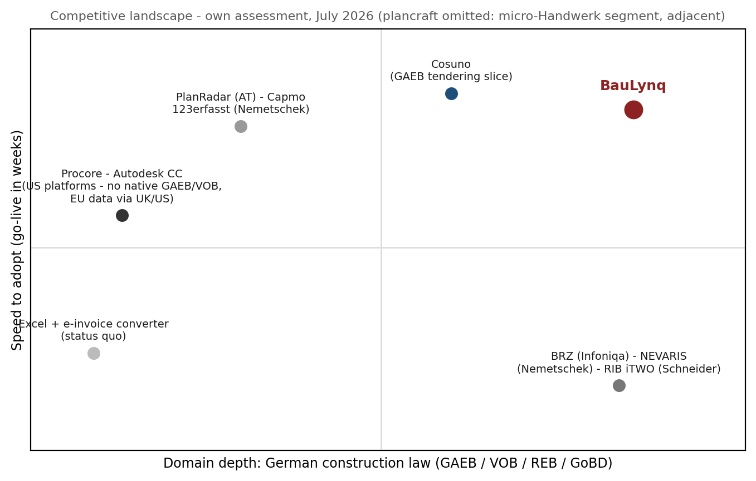
US platforms lead the category — not the German stack.
German players sell ERPs or slices; the sovereign continuous record in the middle is open for ~24 months.
Procore · Autodesk CC — $1.32bn rev. / AECO $3.58bn — but no advertised GAEB/VOB/XRechnung; Procore has no EU application zone (EU app data via UK, estimating via US).
ERPs: BRZ (Infoniqa) · NEVARIS (Nemetschek) · RIB iTWO (Schneider) — Master German law, but their revenue model IS the implementation project — a 21-day product cannibalizes it. None independent anymore.
Slice specialists: Cosuno (GAEB tendering, ~€45m) · PlanRadar (AT) · Capmo · 123erfasst — Each digitalizes one phase → new data islands. Cosuno stops at award — exactly where the margin leak begins.
Status quo: Excel + converter — The real competitor in most deals — satisfies the mandate, not the month-end. (plancraft: >€50m, but micro-Handwerk office software — adjacent, not competing.)
BauLynq — Seed · July 2026 · Confidential · draft figures (Entwurf)
7

Slide 8
The German answer to Procore & Autodesk
Von Deutschen, für Deutsche — dann für die Welt. The sovereignty demand is measured, not assumed.
$1.32bn
0
85%
91%
Procore revenue FY2025 —
the category is proven at scale
EU application zones at Procore —
EU app data via UK, estimating via US
of German companies: too dependent
on US cloud (Bitkom 2026, n=603)
would prefer a German cloud
provider (Bitkom 2026)
The gap is structural: no US platform advertises native GAEB, VOB billing, REB or XRechnung support — German AVA/GAEB directories list exclusively German-speaking vendors; ACC's Germany data residency covers only part of its suite. A German contractor's prices, margins and audit trail either stay in Excel — or cross the Atlantic.
BauLynq: German domain model at the core (not a partner plug-in) · hosted in the EU (Azure West Europe) · German-language support · transparent €490–1,490/mo vs. Procore's opaque volume-linked $10–80k/yr (third-party estimates).
The playbook is proven: DATEV owns German tax software against Intuit. Personio won European HR against Workday. Nemetschek (€1.19bn) proves German AEC software scales globally. Same sequence: home market on compliance depth first — then DACH, then outward.
BauLynq — Seed · July 2026 · Confidential · draft figures (Entwurf)
8

Slide 9
Land in 21 days. Expand to the platform.
The funnel is stated, not implied — and onboarding capacity gates the sales plan, not the reverse.
40
12
3.0
2.5
→
→
→
qualified leads / mo
founder network · pilot referrals · inbound
demos / mo
30% lead→demo — “a working session, not a sales call”
closes / mo
25% demo→close · ~3-month pilot-led cycle
used in the plan
ramp headroom for AE #1
The 21-day go-live — precisely scoped
Pilot cohort H2 2026
Days 1–5 GAEB data migration (current LVs, master data)
Days 6–10 training on the first module
Days 11–21 first live billing run, parallel to the old process
Scope: first productive module (BidX or InrX) on one live project. Payroll excluded. Full platform: 3–6 months, land-and-expand.
8 companies · €250/mo special terms · close support
Success = go-live ≤21 days · one full billing cycle · reference agreement
75% conversion to paid in Jan 2027 (base case)
Expansion is modeled, not hoped: 1%/mo of the Starter base upgrades to Professional (base case). Onboarding capacity: 3–4 go-lives per FTE per month → two dedicated hires.
BauLynq — Seed · July 2026 · Confidential · draft figures (Entwurf)
9

Slide 10
Recurring, modular — with a 3× expansion path in every account
SaaS per module & seat, bundled in three tiers · one-time onboarding priced to cover delivery.
Starter
Professional
Enterprise
€490 / month
€1,490 / month
on request annual
1 module · up to 5 seats
hosted in the EU
all 10 modules · up to 25 seats
e-invoicing & GoBD archive
unlimited seats · on-premise · SLA
roadmap 2027 — lifts ACV to €40–60k
Land €490/mo (1 module, ~5 seats) → Expand €1,490/mo (10 modules, ~18 seats) = 3.0× ACV without acquisition cost + Onboarding €2.5k / €5k one-time
Why customers stay: BauLynq holds the system of record — LV history, measurement chains, the GoBD-immutable billing archive. Leaving means exporting a legal audit trail mid-project. Base case still assumes 1.25%/mo gross churn (~14%/yr), above the promo draft and benchmark-anchored; conservative case 2.0%.
BauLynq — Seed · July 2026 · Confidential · draft figures (Entwurf)
10

Slide 11
Self-funded: €1.2m ARR. Funded: €2.0m.
Monthly model Jul 2026 – Dec 2029 · cohort tiers · commissions · wage inflation · tax · sensitivity-tested.
ARR counts subscriptions only — pilot fees are never annualized. Every scenario is EBITDA-positive by 2028 except Conservative (−€108k), which re-phases hiring and still keeps positive cash.
BauLynq — Seed · July 2026 · Confidential · draft figures (Entwurf)
11

Slide 12
Four scenarios, one machine
The Zielbild from the original deck is reproduced as one case of the same model — not a separate story.
Conservative
Base (self-funded)
Funded acceleration
Zielbild (draft)
Customers (end-2028)
54
96
145
105
ARR (end-2028)
€0.58m
€1.18m
€2.00m
€1.74m
EBITDA 2028
−€108k
+€128k
+€656k
+€495k
Peak pre-funding cash need
€310k
€277k
€206k
€201k
Min. post-funding cash
+€74k
+€15k
+€7k
+€12k
LTV / CAC (48-mo cap)
6.0×
7.8×
10.5×
10.1×
Stress-tested: the workbook's churn × sales-plan grid shows no modeled path in which the company runs out of money with the round closed — the worst corner (2% churn × 40% plan) is exactly the case the conservative scenario answers with a 6-month hiring re-phase.
BauLynq — Seed · July 2026 · Confidential · draft figures (Entwurf)
12

Slide 13
Unit economics that survive diligence
Base case 2028 — full S&M in CAC, lifetime capped at 48 months, churn set above our own draft.
€1,025
84%
≈ €5.3k
ARPA — blended MRR
(60/40 Pro/Starter mix)
gross margin
(incl. support personnel)
CAC — marketing +
commissions + sales comp
≈ €41k
7.8×
6.1 mo
LTV — capped at 48 months
(no 11-year lifetimes)
LTV / CAC
benchmark: ≥3× fundable, ≥5× strong
CAC payback
bar: <18 months for SMB SaaS
Sources: High Alpha SaaS Benchmarks 2024 · Tidemark Vertical & SMB SaaS Report 2025. Churn 1.25%/mo (~14%/yr) vs. promo draft 0.75%.
BauLynq — Seed · July 2026 · Confidential · draft figures (Entwurf)
13

Slide 14
Counted bottom-up — and a ceiling that moves
≈4,540 German target firms today; DACH, Enterprise ACV and the SMB band carry TAM past €300m.
≈ €560bn
4,695
≈ 4,540
2.2%
German construction volume / yr
(DIW Bauvolumenrechnung)
firms 50–249 (4,310) + 250+ (385)
Destatis 2024, verified
target firms 50–500 employees
(SAM) ≈ €56–81m ARR
SAM penetration needed
for 100 customers
DACH from 2028 — ≈ +1,750 firms in Austria & Switzerland (estimate) — same VOB-adjacent norms, same GAEB files.
ACV expansion — Enterprise tier + seat overage lift ceiling ARPA from €17.9k toward €40–60k for 250–500-employee firms. Today's €1,490 cap is a pricing decision, not a market limit.
The 10–49 band — ≈30k smaller firms addressable with a lighter SKU after 2028 — the micro-Handwerk segment plancraft serves today, attacked from above with compliance depth.
BauLynq — Seed · July 2026 · Confidential · draft figures (Entwurf)
14

Slide 15
Three founding engineers. Four hires to scale.
Every hire has a date, a cost and a trigger — and the code-level key-person risk is answered, not hidden.
Founding team — three engineers
Nov 26
Sales / AE #1
own the demo→pilot funnel
Mohamad El Ejel — Founder, Product & Engineering. Knows the Excel reality from his own project work; designed and wrote the entire platform — 12 module areas, 1,465 tests, built.
Salah Alabdallah — Co-founder, Construction & Operations. Engineer, currently at Deutsche Bahn — infrastructure operations discipline and the client-side (AG) perspective.
Majd El Ejel — Co-founder, Engineering. Mechanical Engineering, Otto von Guericke University Magdeburg.
Code continuity: runbooks · credential escrow · key-person insurance at closing · Engineer #1 mandated to shared code ownership.
Feb 27
Onboarding & Support #1
own the 21-day promise (>5 accounts)
Jul 27
Engineer #1
DATEV export · bus-factor → 2 (≥€15k MRR)
Jan 28
Sales / AE #2
second territory (AE#1 at quota)
Jul 28
Support #2 + Engineer #2
~6 go-lives/mo · API layer (≥60 accounts)
BauLynq — Seed · July 2026 · Confidential · draft figures (Entwurf)
15

Slide 16
The ask: €500k seed
Turns a self-sustaining €1.2m-ARR plan into a €2.0m-ARR plan — and de-risks the downside for free.
Core team (4 hires through 2027)
€330k
sales · onboarding · engineering
Go-to-market & marketing
€90k
BAU/digitalBAU · content · paid acquisition
Infrastructure, certification & buffer
€80k
hosting · ISO 27001 track · key-person insurance · reserve
Milestone it buys: ≥34 customers & ≥€364k ARR end-2027 (base) — Series-A-ready — or ~50 customers in the funded case.
Runway: through cash-flow positive in all four scenarios; minimum post-close cash never negative.
Sizing: ~1.6× the conservative-case peak need (€310k); the remainder is the acceleration delta (+~€0.8m ARR end-2028).
Corporate & IP at closing: entity finalized · all IP assigned · founder accepts 4-year vesting · no debt · 100% founder-owned.
BauLynq — Seed · July 2026 · Confidential · draft figures (Entwurf)
16

Slide 17
Die Plattform, die den Bau verbindet.
German construction-law depth is what global platforms acquire rather than build.
Autodesk / PlanGrid
Nemetschek
RIB → Schneider
PlanRadar · plancraft · Ecoworks
$875m
serial acquirer
(Nevaris · 123erfasst)
ERP consolidation
$69m B · €40m · €40m
Book a demo — 30 minutes, a working session, not a sales call.
info@baulynq.com · +49 1525 4966510 · www.baulynq.com · app.baulynq.com
Confidential · figures are planning status July 2026 (Entwurf) · full detail: Business Plan v2 (PDF) + Financial Model (XLSX)

